Slide 1
Comic Web-Store Database Design
Bolong yan

Slide 2
Mini-World Introduction
My database is used for a comic store.
Our store also has online-shopping website.
We serve consumers to buy books faster and we offer them a return method.

Slide 3
Goals of My Database
Enable fast shopping guide
Customer can search the comic books by using the search engine in a few second. They pay the money for the products. Credit cards are enabling.
Enable fast receive
The integration of shipment capabilities will help to reduce the delivery period. Customers will receive their products in 24 hours.
Enable high effective return services
The customer service will receive the feedback which is written by customers on time. They will contact the customers after the orders are received. Assiduous after-sales service is one reason why the database is important.
Enable high-quality management
When there are less than 20 books left, the system will remind automatically. The manager can contact the authors. So, new comic books will be advertised on time from the database

Slide 4
Entities in My Database
Consumer
They will register their accounts with name, password, gender, and phone number. Then, they can search the books which they want to buy from the database.
Product
The comic books are registered by the name, author and rating and publication date. Consumers can find their targets easily.
Employee
They will help the Consumers finish the purchases, receive the feedback messages, mail the products, and receive the returns. The database records with their name, gender, and work experience. We also have high-level employee as our manager to manage the store and staffs
Distributor
The distributor will receive the purchase orders from employee. They will provides the sufficient and high-quality comic books to the book store.

Slide 5
Transaction in My Database
Buy Order
This is the core of the database system. It links the products with consumers, employees, and distributors. The store will receive the money automatically from the credit cards and engage automatic consignments. It also can track the shipment status and receive the feedback from consumers.
Shipment
After receive the money; the employees will mail the books to the consumers.
Return
If the consumers are dissatisfied, they will return the books. The employees will receive the return orders and track the shipment status.
Purchase Order
The employees will order new books from publishing companies.

Slide 6
Direct Users and Indirect Users
Direct users:
Book store employees
Use the database for services.
Book store manager
Use the database for get the feedback messages
In-direct users
Consumers
They will search the books from the database.
Administrator
People who is responsible for database management and technical support.

Slide 7
Output
Consumer information
It includes consumers’gender, birthday, address, phone, and credit cards.
Feedback
When the consumers are purchasing, their information and orders will be seen by the employees. Therefore, the feedbacks will help them to finish the return.
Total price
When the consumers confirm the purchase, the system will automatic calculate the spends.

Slide 8
Output
Rating
When children are searching the comic books, the mature contents can be blocked automatically.
Returning report
Database will record the satisfactions or dissatisfactions from the consumers.
Shipment status
Enable mail tracking. Consumers will check their mails on website.
Publishing companies report
Database will give list of supplier and their information.

Slide 9
Output
Shortages report
Distributor will deliver the products more accurate by grabbing the information from the store manager.

Slide 10
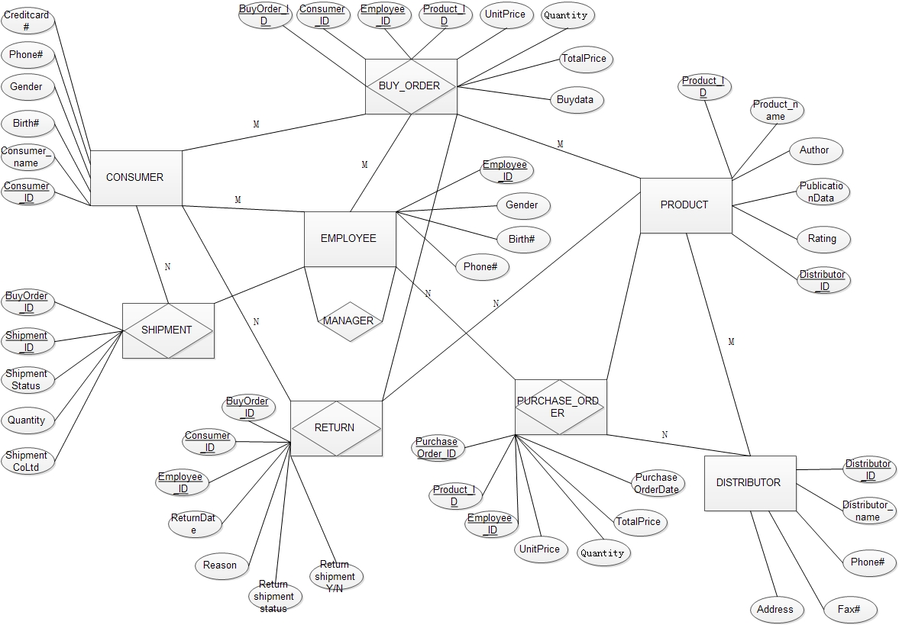
ER Diagram

Slide 11
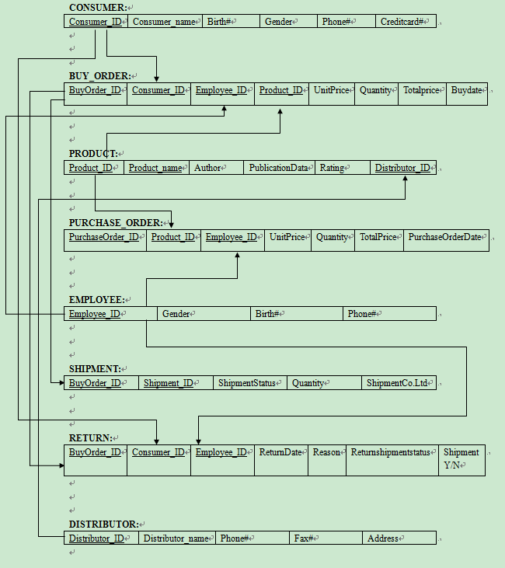
Logic Diagram

Slide 12
Thank you!

